Slide 1


AIL 411-DEEP LEARNING LAB
PREPARED BY: ASHA ROSE THOMAS
AP,CSE(AI),ASIET,KALADY

Slide 2
EXPERIMENT 6
Digit classification using pre-trained networks like VGGnet-19 for MNIST dataset and analyse and visualize performance improvement.

Slide 3
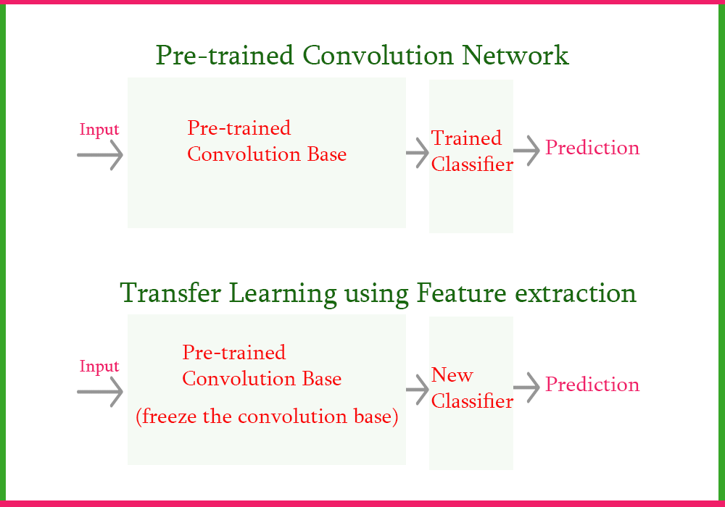
Transfer Learning: Leveraging Pre-trained Models
Notes:
Transfer Learning Using Feature Extraction In Deep Learning | by Nutan | Medium

Slide 4
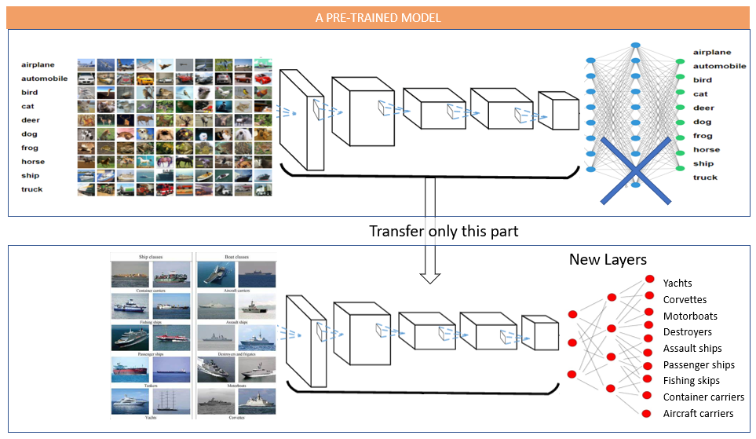
Transfer Learning

Slide 5
Transfer Learning: Leveraging Pre-trained Models
Transfer learning: Reusing knowledge from one task to another.
In CNNs, leverage pre-trained models on large datasets (e.g., ImageNet).
Steps:
  Choose a pre-trained model.
  Freeze initial layers (feature extraction).
  Replace/modify final layers for new task.
  Fine-tune the model on new data.
Example: Fine-tune a model trained on ImageNet to classify medical images.

Slide 6
Reference

